Slide 1

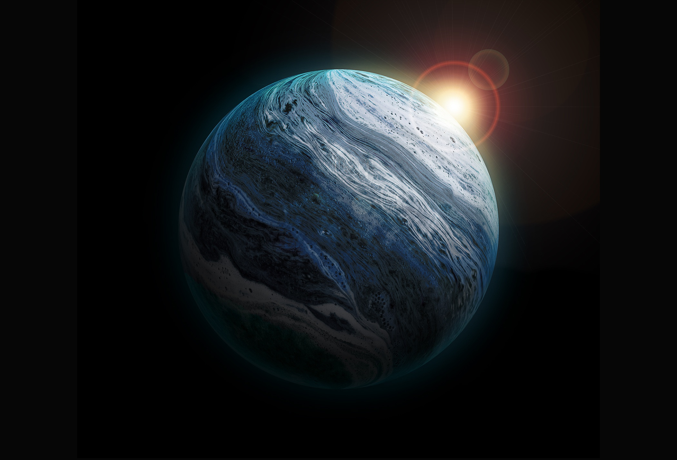

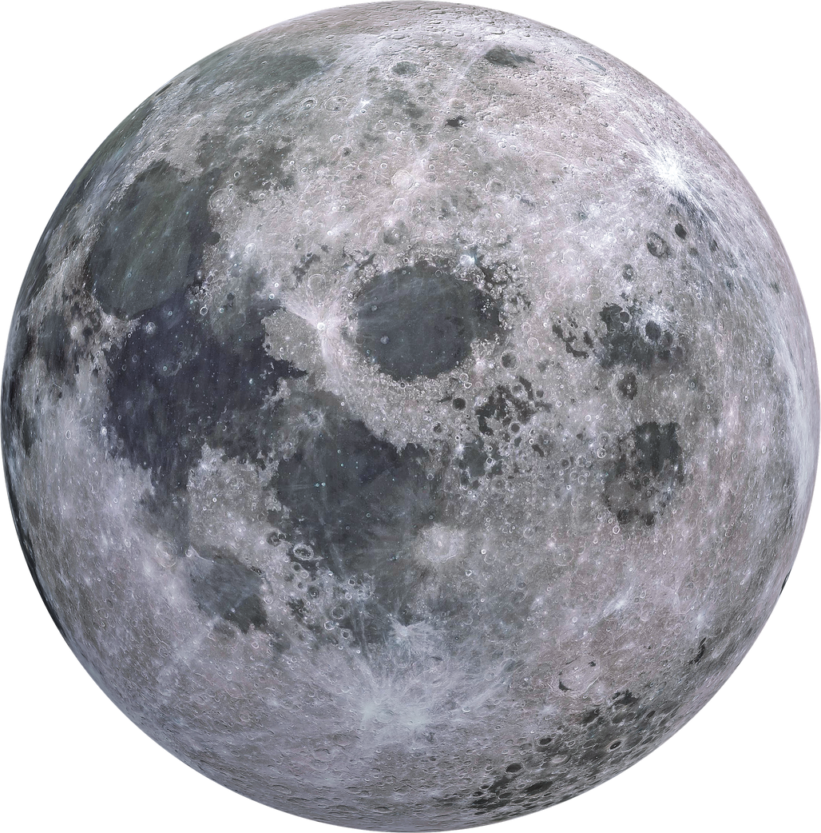
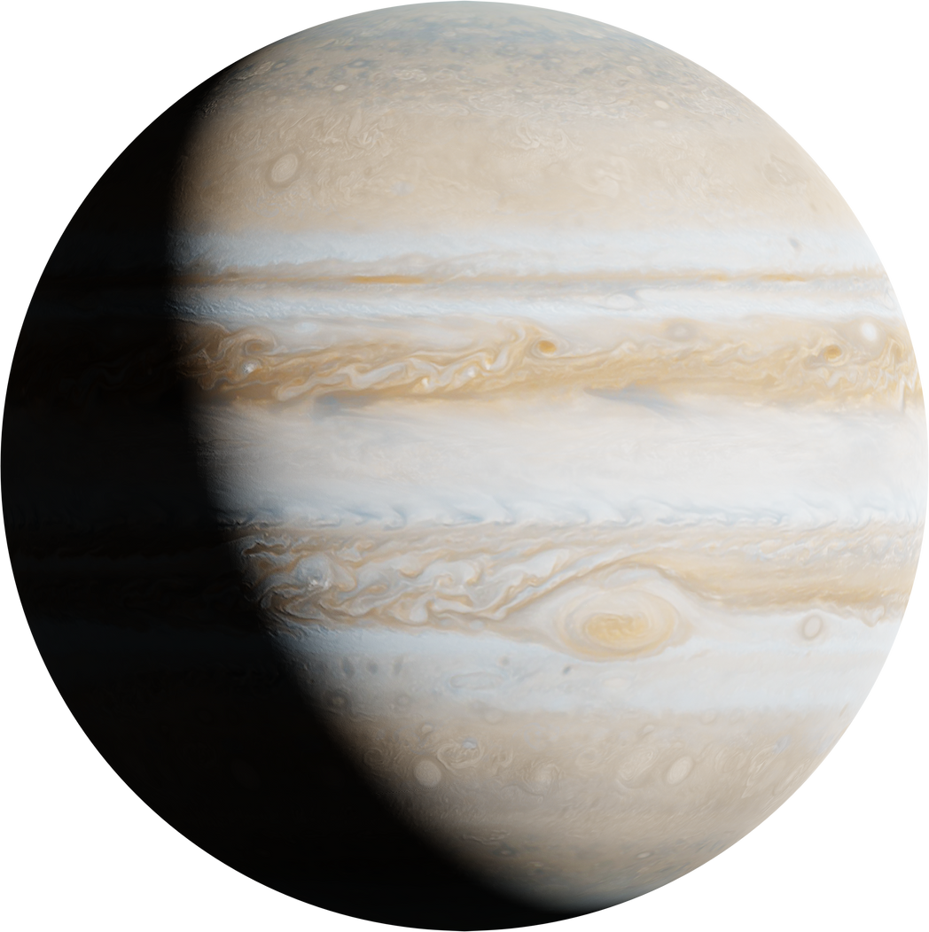

Sulfur surfers
HOME
ABOUT
CONTENT
OTHERS
SULFUR SURFERS EXPLORING THE WONDERS OF OUR SOLAR SYSTEM AND ITS CELESTIAL BODIES
Exploring the wonders of our Solar System and its celestial bodies
PAGE 01
www.planetarywikipedia.com

Slide 2
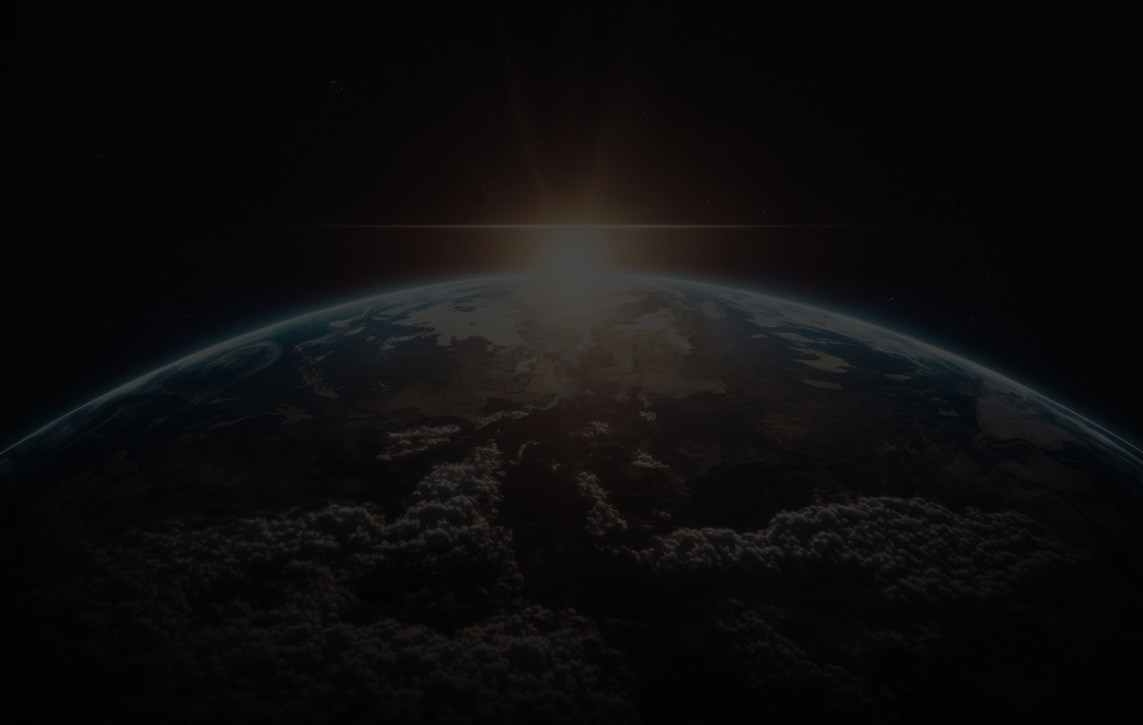
Sulfur surfers
HOME
ABOUT
CONTENT
OTHERS
This presentation will take you on a brief tour of our cosmic neighborhood. We'll journey from our central star, the Sun, to the rocky inner planets and the gas giants of the outer solar system. Prepare to explore fascinating moons, mysterious asteroid belts, and the unique characteristics of each celestial body.
About This Presentation
PAGE 02
www.planetarywikipedia.com
Notes:
This presentation offers a concise exploration of our cosmic neighborhood. We will traverse from our central star, the Sun, to the rocky inner planets and the gas giants that populate the outer solar system. Prepare to delve into the intriguing moons, enigmatic asteroid belts, and the distinctive attributes of each celestial body.

Slide 3
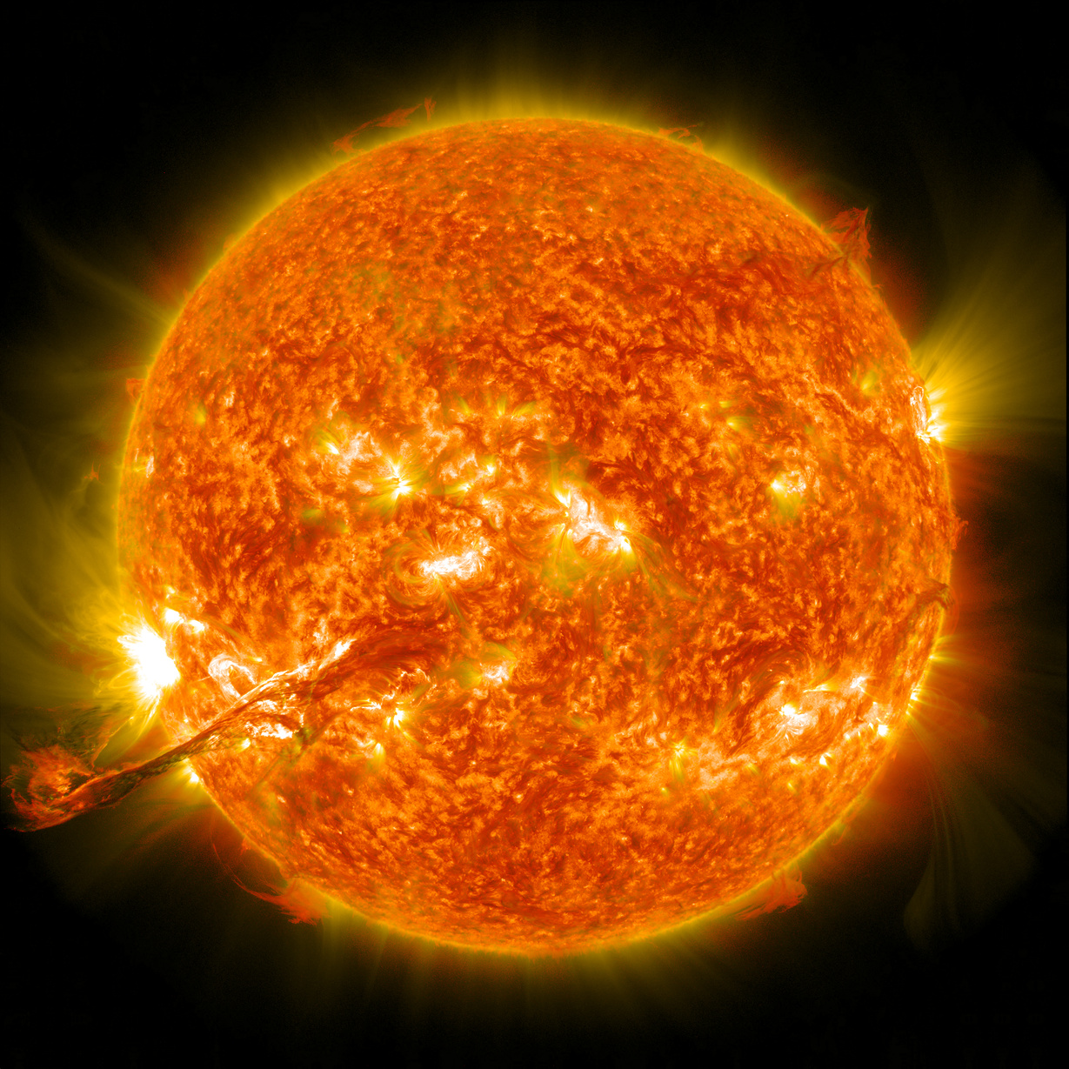
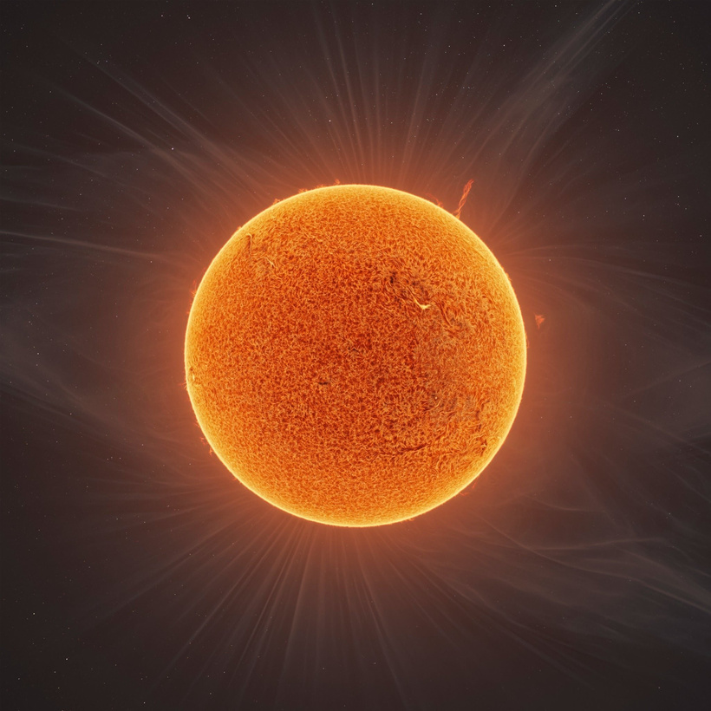
Sulfur surfers
HOME
ABOUT
CONTENT
OTHERS
Sun Facts
The Sun is a yellow dwarf star and is the heart of our solar system, accounting for 99.8% of its total mass. Its core reaches temperatures of about 15 million degrees Celsius (15*10^6 °C), which is hot enough to sustain nuclear fusion, converting hydrogen to helium and releasing tremendous energy. The light from the Sun takes about 8 minutes and 20 seconds to reach Earth.
PAGE 03
www.planetarywikipedia.com

Slide 4
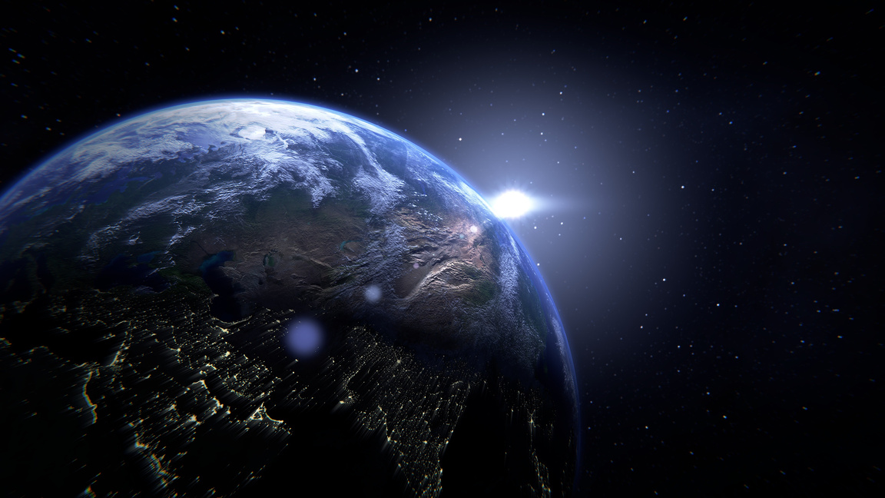
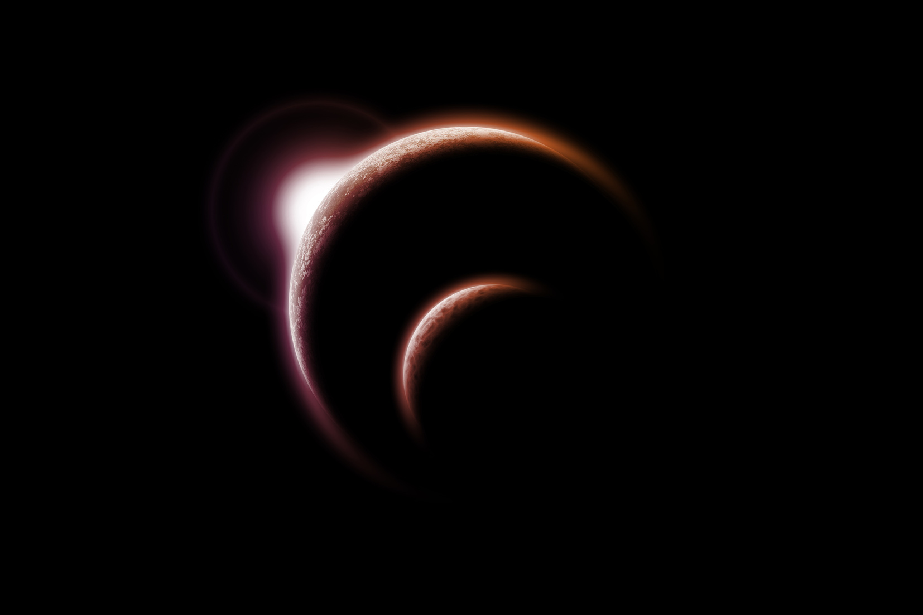
Sulfur surfers
HOME
ABOUT
CONTENT
OTHERS
Planet Types
Our solar system has two main categories of planets: Terrestrial Planets: These are the inner, rocky planets: Mercury, Venus, Earth, and Mars. They are smaller, denser, and have solid surfaces. Jovian Planets: These are the outer giants. Gas Giants (Jupiter and Saturn): Massive planets composed mostly of hydrogen and helium. Ice Giants (Uranus and Neptune): Composed of heavier elements like water, methane, and ammonia ice.
PAGE 04
www.planetarywikipedia.com

Slide 5
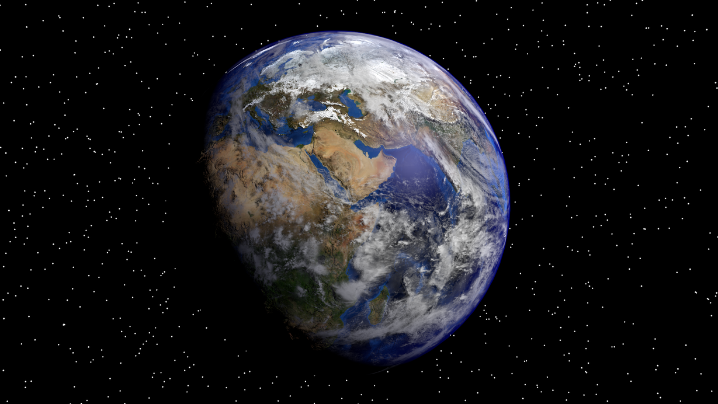

Sulfur surfers
HOME
ABOUT
CONTENT
OTHERS
Earth Study
Habitability
Habitability Earth is unique because it lies within the "Goldilocks Zone", the perfect orbital distance from the Sun to allow liquid water to exist. This, combined with a protective atmosphere and a magnetic field, creates the ideal conditions for life to thrive.
Atmospheric Layers
Our atmosphere is composed of several layers (Troposphere, Stratosphere, Mesosphere, Thermosphere, Exosphere). It is made up of approximately 78% nitrogen and 21% oxygen, protecting us from harmful solar radiation and regulating our planet's temperature.
PAGE 05
www.planetarywikipedia.com

Slide 6
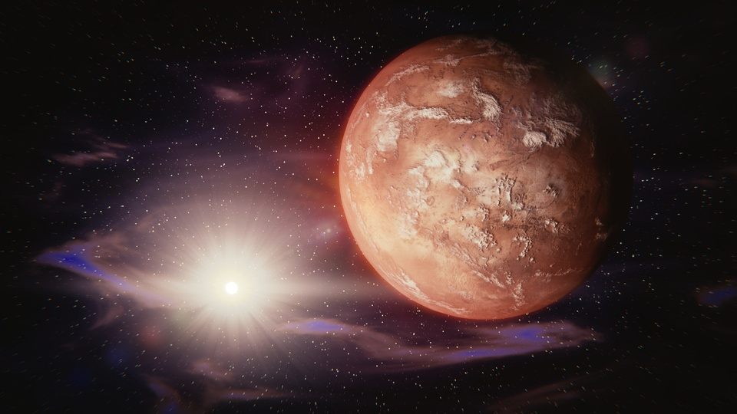
Sulfur surfers
HOME
ABOUT
CONTENT
OTHERS
Mars Mission
Exploration Rovers
Water Discovery
NASA's rovers, such as Curiosity and Perseverance, act as robotic geologists. They study the Martian landscape, analyze rock and soil samples, and search for evidence of past microbial life, helping us understand the planet's history.
While Mars's atmosphere is too thin for liquid water to last long on the surface, rovers and orbiters have found strong evidence of ancient riverbeds, deltas, and lakes. Today, water is primarily found as ice in the polar caps and underground.
PAGE 06
www.planetarywikipedia.com

Slide 7
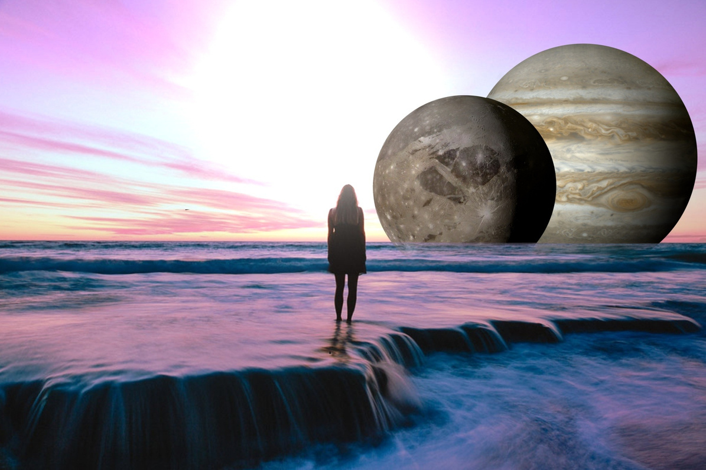
Sulfur surfers
HOME
ABOUT
CONTENT
OTHERS
Jupiter's Moons
Jupiter has 95 confirmed moons, but the four largest, known as the Galilean moons, are worlds in their own right. Io: The most volcanically active body in the Solar System. Its volcanoes spew vast plumes of sulfur, giving it a distinct yellow, red, and orange appearance. Europa: Covered by an icy shell that is believed to hide a global saltwater ocean, making it a top candidate in the search for extraterrestrial life. Ganymede: The largest moon in the solar system, even bigger than the planet Mercury. Callisto: A heavily cratered, ancient world.
PAGE 07
www.planetarywikipedia.com

Slide 8
Sulfur surfers
HOME
ABOUT
CONTENT
OTHERS
Asteroid Belt
Location in System
The Asteroid Belt is a vast, ring-shaped region located between the orbits of Mars and Jupiter. It is not as densely packed as often depicted; spacecraft can fly through it safely.
Rocky Composition
It contains millions of asteroids, which are rocky remnants from the early formation of the solar system. The largest object in the belt is the dwarf planet Ceres, which is about 940 km (585 miles) in diameter.
PAGE 08
www.planetarywikipedia.com

Slide 9
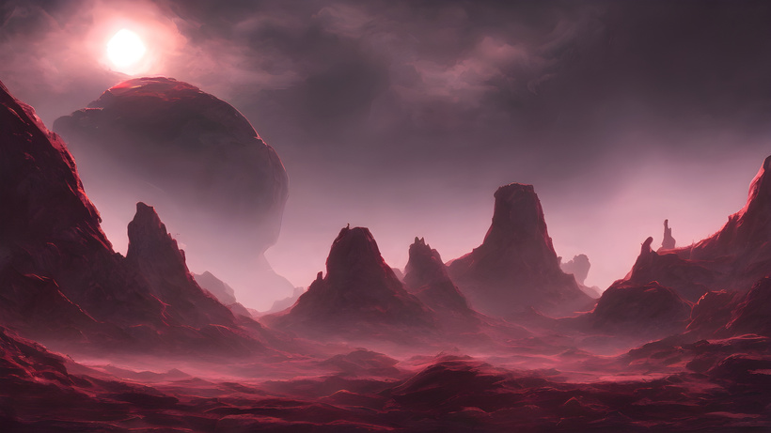
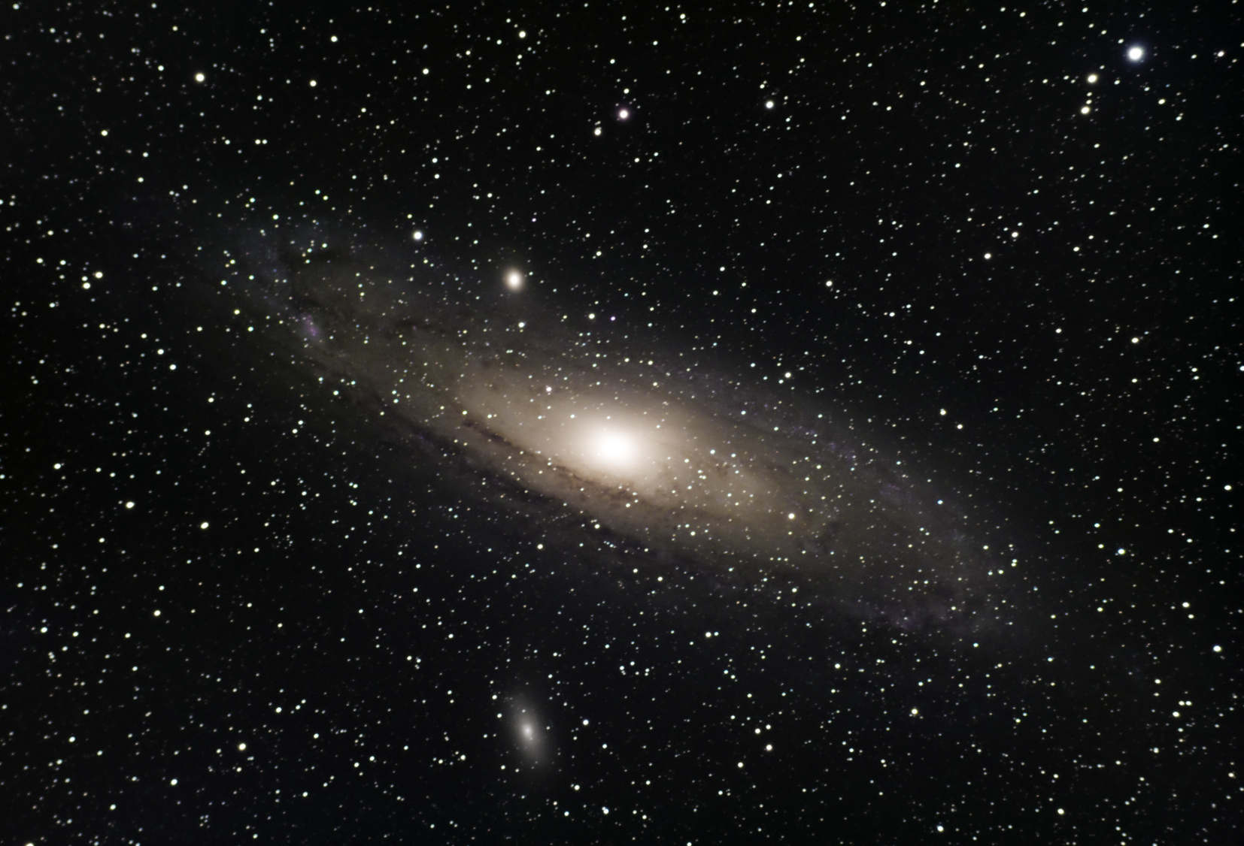
Sulfur surfers
HOME
ABOUT
CONTENT
OTHERS
Outer Planets
Distance from Sun
Unique Features
Atmospheric Composition
The Jovian planets—Jupiter, Saturn, Uranus, and Neptune—are located far from the sun, resulting in frigid temperatures and vastly different environments compared to the inner planets.
Jupiter has the Great Red Spot, a storm larger than Earth. Saturn is renowned for its spectacular rings made of ice and dust. Uranus rotates on its side at a 98-degree angle. Neptune is the windiest planet, with winds reaching over 2,000 km/h.
These planets are primarily composed of hydrogen and helium. The trace amounts of methane in the atmospheres of Uranus and Neptune are what give them their beautiful blue colors.
PAGE 09
www.planetarywikipedia.com

Slide 10
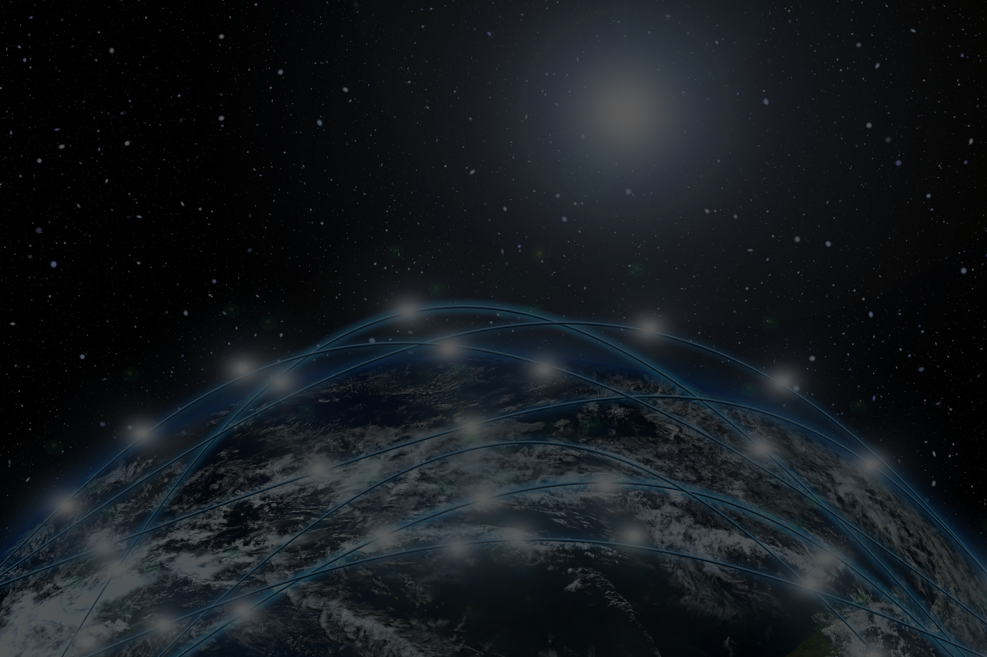

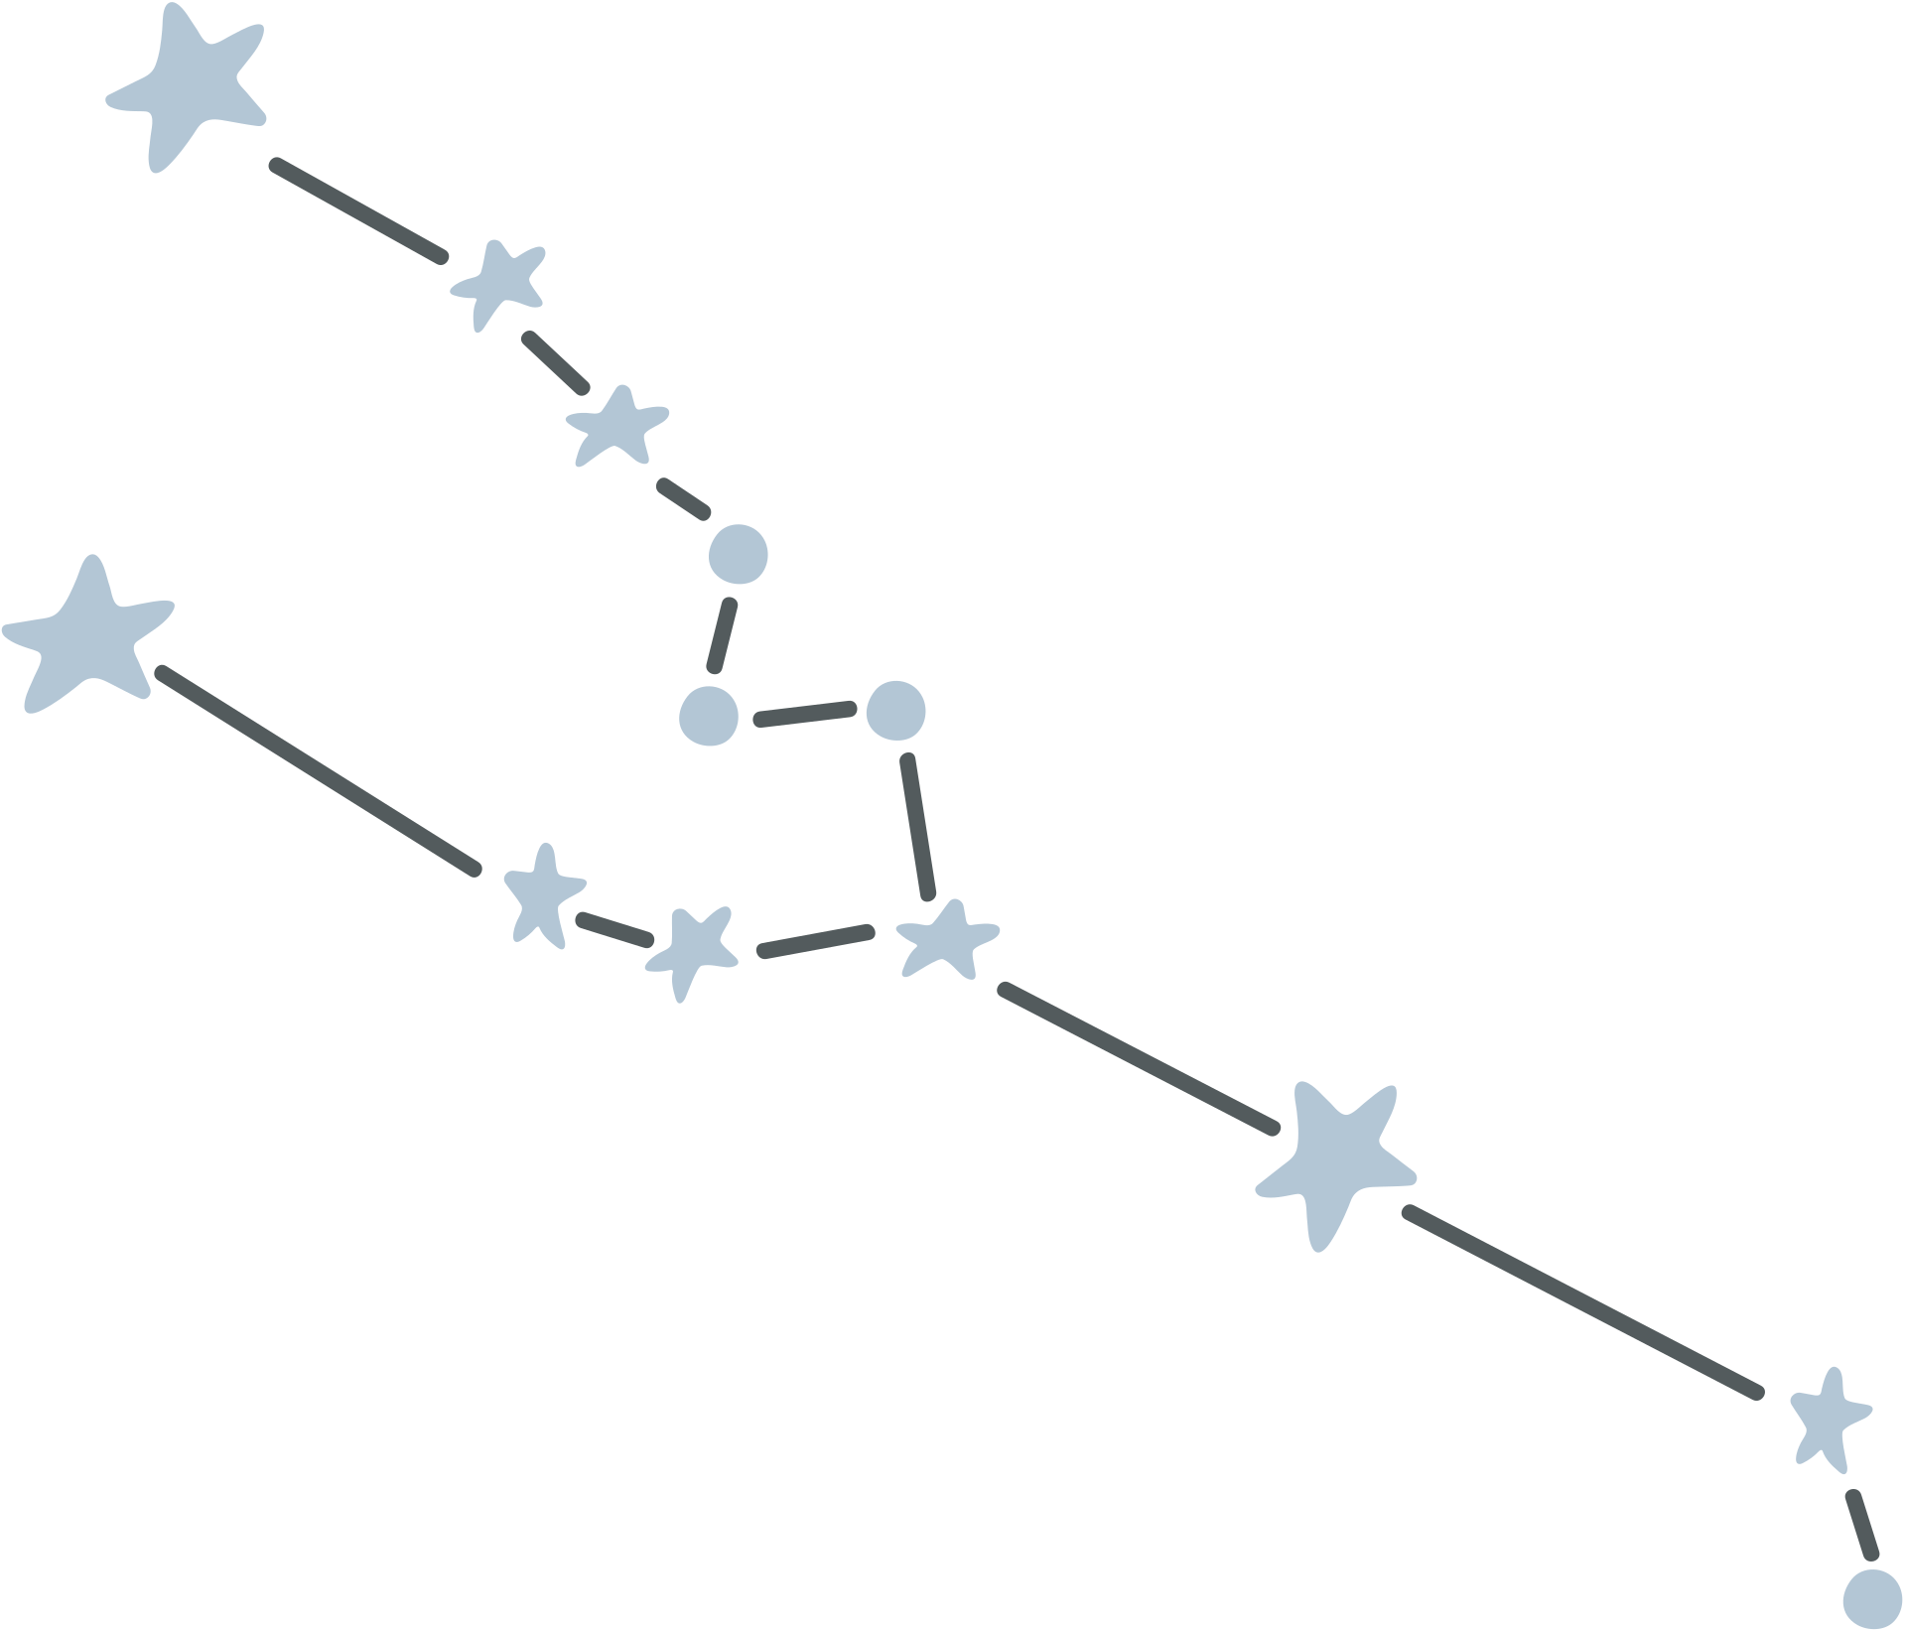
Sulfur surfers
HOME
ABOUT
CONTENT
OTHERS
THANK YOU!
Thank you for joining this journey through the Solar System. Keep looking up and exploring the stars!
PAGE 10
www.planetarywikipedia.com

Slide 11
Sulfur
Surfers
Himanshu :- himail.work8787@gmail.com
Divyanshu Singh :- div892025@gmail.com
Samvat Dixit :- samvatdixit02@gmail.com
Rahul Tanwar :- tanwarrahul889@gmail.com
Manas Shandilya :-manas.shandilya.2006@gmail.com
Durgesh Rajpurohit :- durgeshrajpurohit685@gmail.com

